Slide 1
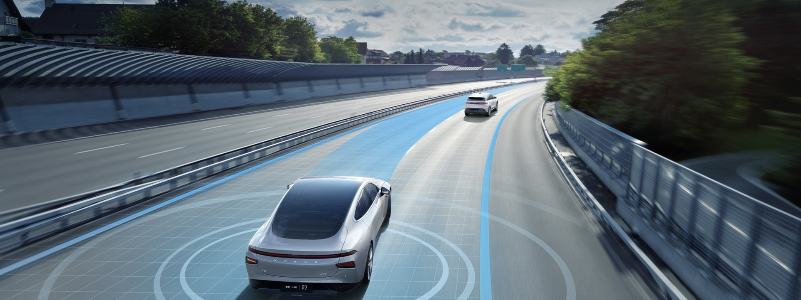
Internet of Vehicles: Network Architecture & Applications
Elvis Yeboah-Duako
MSc. Computer Science & Technology

Slide 2
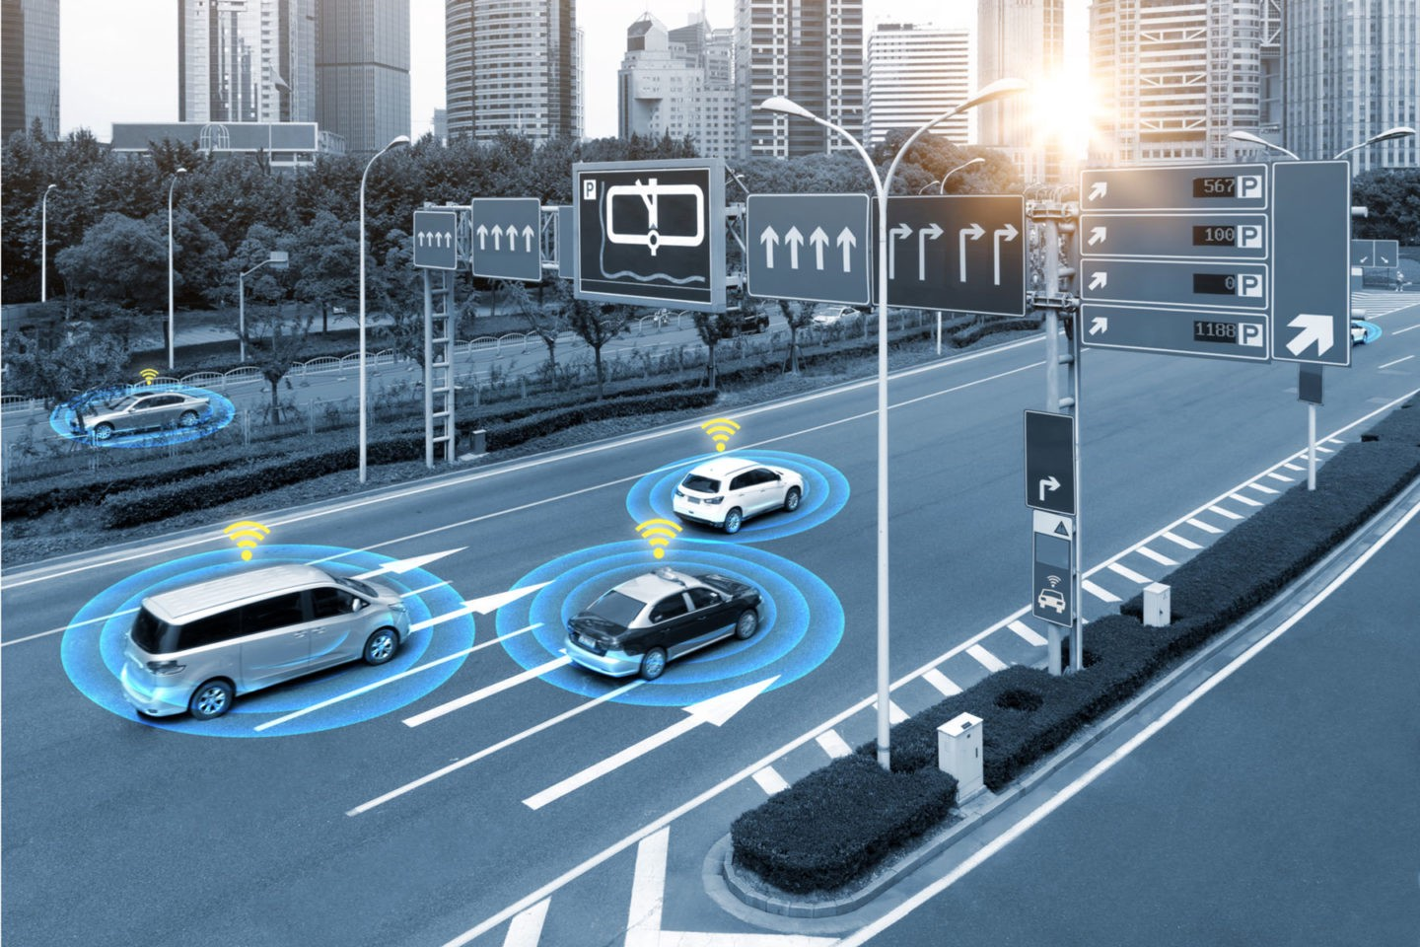
Presentation Outline
1. Introduction
2. Vehicular Ad-hoc Networks (VANETs)
3. Components of the VANET System
4. Communication Models of VANETs
5. IoV ad Its Key Communication Models
6. Communication Technologies in IoV
7. System Structure of IoV
8. IoV Network Architectures
9. Proposed IoV Architecture
10. IoV Typical Applications
11. Influence of 5G/B5G on IoV

Slide 3
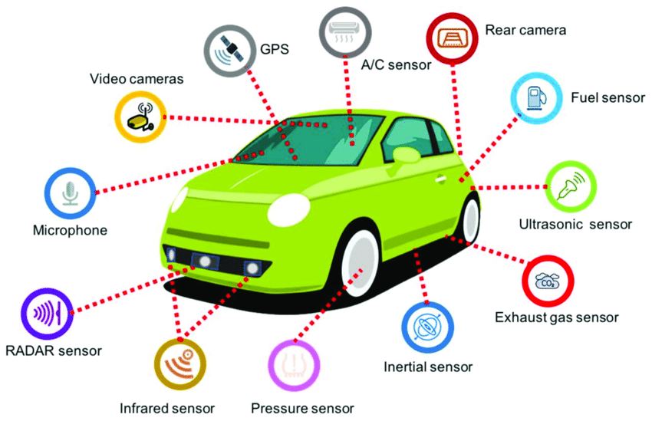
Introduction
Automobiles are transforming from an era of providing mere traditional transportation services to into an intelligent era.
Internet of Vehicles (IoV) = Vehicle networking and vehicle Intelligence
Vehicles equipped with Smart devices such as wireless sensors, on board computers, GPS antennas, radar, and so on can collect and process large amounts of data whole enabling information interaction between vehicles.
Proposals for IoV began in 2003 at the ITU-T Automotive Communications Standardization Conference under the parent name VANETS: Vehicular Ad-hoc Networks
VANETS focused mainly on Vehicle to Vehicle (V2V) communication and Vehicle to Infrastructure (V2I) only whereas IoV expands communication for Vehicle to Everything (V2X)

Slide 4
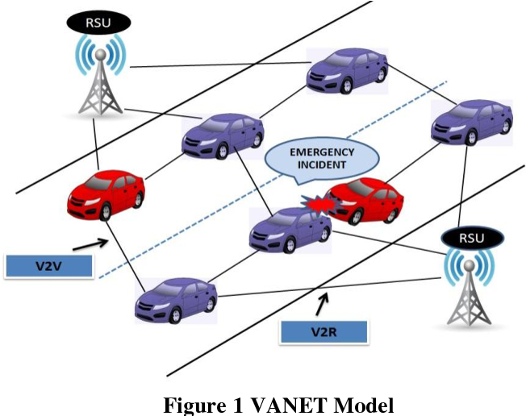
Vehicular Ad-hoc Networks (VANETs)
VANET implies the use of vehicles as mobile nodes or routers in the application of the mobile ad-hoc network (MANET) in the transportation field.
Main purpose was to achieve communication between vehicles (V2V) and communication between vehicles and roadside fixed infrastructure (V2I)
Why VANET not brought to commercial value for a long time
Unstable network service quality
Incompatibility with personal communication devices
Lack of the ability to process big data
It, however, serves as the foundation for IoV.

Slide 5
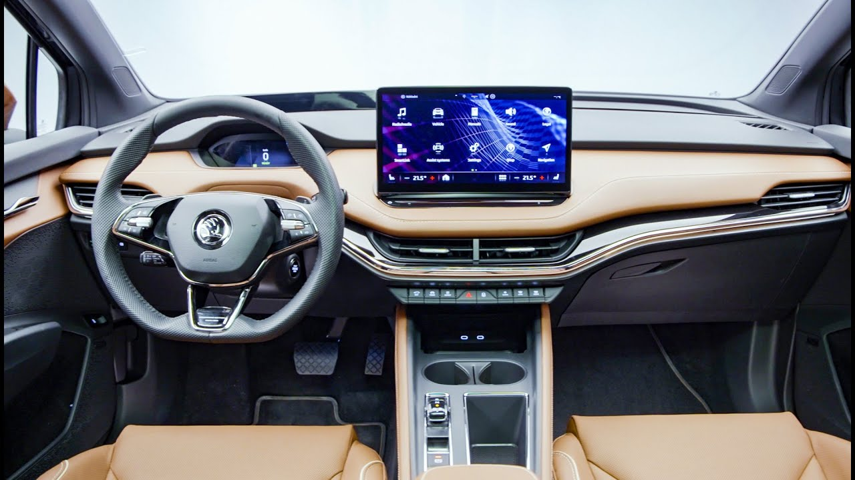
Components of the VANET system
The Onboard Unit (OBU)
consists of electronic components including read/write memory for storing and retrieving information, user interface, a dedicated interface connected to the other OBUs, and network devices for dedicated short-range communication (DSRC).
Main functions are to achieve radio access, geographic routing, network congestion control, reliable transmission of messages, and data security.
Data collected include: speed, acceleration, fuel quantity, ….
Information is sent to a nearby RSU or other vehicles over a wireless network based on the IEEE 802.11p standard.
It can also provide communication services for AU

Slide 6
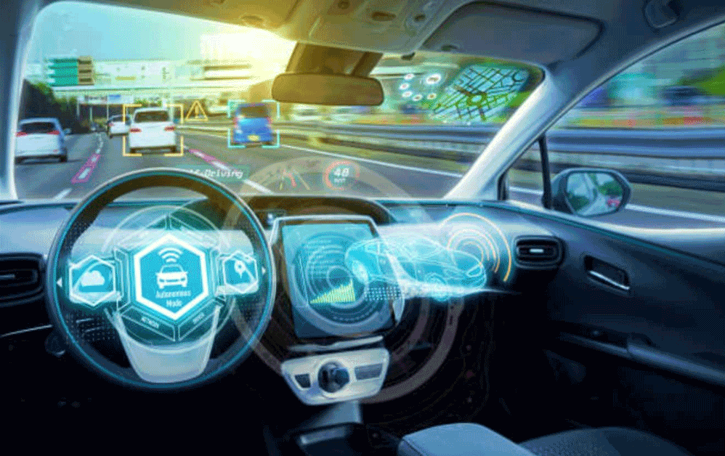
Components of the VANET system
The Application Unit (AU)
A device installed inside the vehicle that can run certain applications.
It can either be a dedicated device for a specific application or a regular device (e.g. A PDA)
It serves as an interface between the driver and the OBU or the VANET system
For instance, with given data, it can provide a visualize view of the road to show paths where congestions are high.
It communicates with the network through the OBU

Slide 7
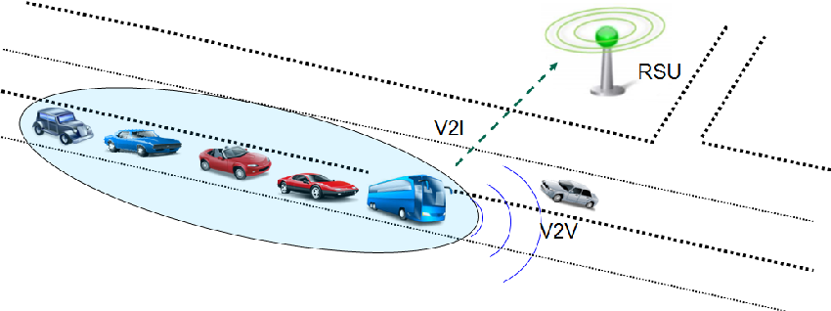
Components of the VANET system
The Road Side Unit (RSU)
Is a communication device installed beside the road or at a designated location.
RSU uses DSRC technology to communicate with the OBU.
Main function
Extends the communication range for vehicles
Serves as a source of information in V2I communication
Provides information such as current road safety for vehicles.
The OBU can access the internet through the RSU

Slide 8
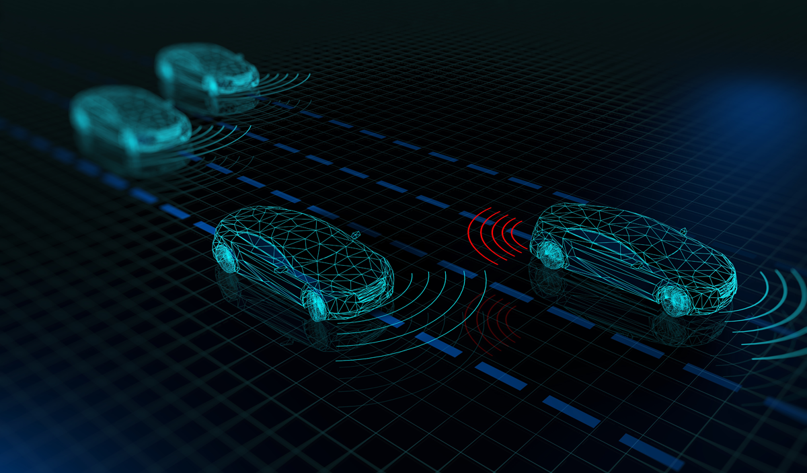
Communication Model of VANET
Onboard Communication
Realized by the OBU and AU
Data taken and transmitted from sensors to OBU processing unit local action
Vehicle to Vehicle Communication
Vehicles can form a MANET using their OBU
They broadcast useful information to each other such as emergency braking, collision detection, and traffic status information thereby improving travel efficiency.

Slide 9
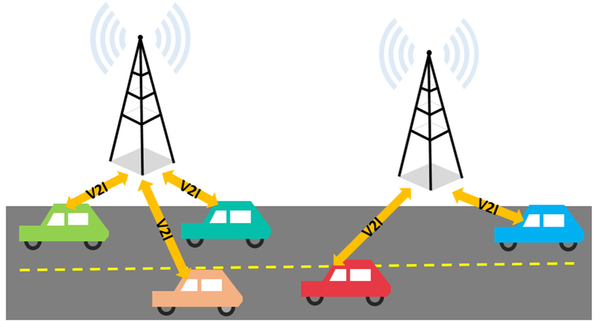
Communication Model of VANET
Vehicle to Infrastructure Communication
Enables information exchange between vehicles and other networks such as the internet.
Expands the communication range
Provides drivers with more comprehensive information on transportation and environment.
It ensures the safety of pedestrians and drivers and improves the efficiency of the traffic management system

Slide 10
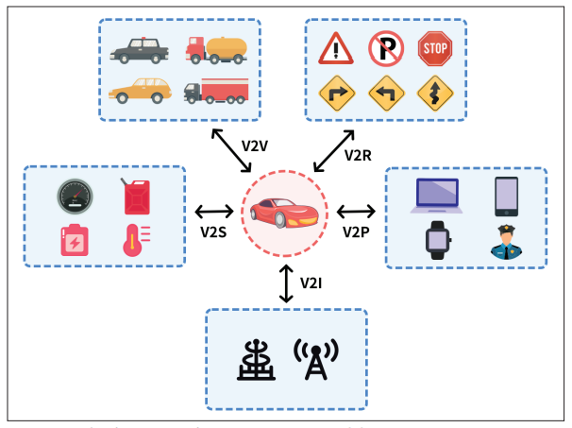
IoV and its Communication Models
IoV is the evolution of that conventional VANET, which refers to the network of different entities, such as vehicles, pedestrians, roads, parking lots and city infrastructure and provides real-time communication among them
IoV introduces information interactivity between the vehicle and all entities that may affect the vehicle. (V2X)
Aim is to:
- reduce accidents
- alleviate traffic congestion
- provide other information services
5 Key Communication Models in V2X
Vehicle to Vehicle (V2V)
Vehicle to Infrastructure (V2I)
Vehicle to Roadside (V2R)
Vehicle to Pedestrian (V2P)
Vehicle to Sensors (V2S)

Slide 11
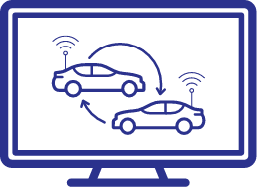
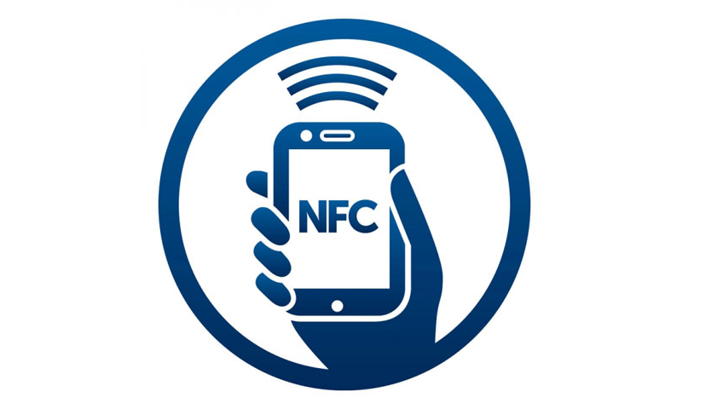
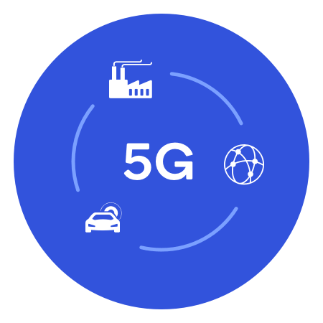
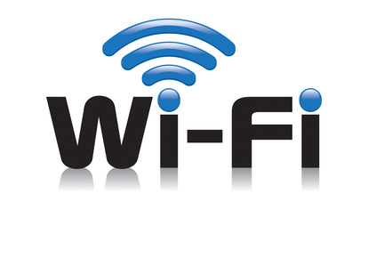
Communication Technologies in IoV
Wireless Access in Vehicular Environments (WAVE)
Vehicle to Vehicle (V2V)
Vehicle to Roadside (V2R)
LTE/4G/5G/B5G
Vehicle to Infrastructure (V2I)
Near Field Communication (NFC)
Vehicle to Pedestrian (V2P)
Wireless Fidelity / Ethernet
Vehicle to Sensors (V2S)
Notes:
WAVE = Wireless Access in Vehicular Environments
A wireless access in vehicular environments (WAVE) system provides interoperable, efficient, and reliable radio communications in support of applications offering safety and convenience in an intelligent transportation system (ITS). In many of the ITS application scenarios, the WAVE system is designed to provide vehicles with the direct connectivity to other vehicles (V2V), to roadside (V2R), or to infrastructures (V2I) through dedicated short-range communications (DSRC). In the USA, DSRC is used to refer to radio spectrum in the 5.9 GHz band or technologies associated with WAVE. While outside the USA, DSRC may refer to a distinct radio technology operating at 5.8 GHz.

Slide 12
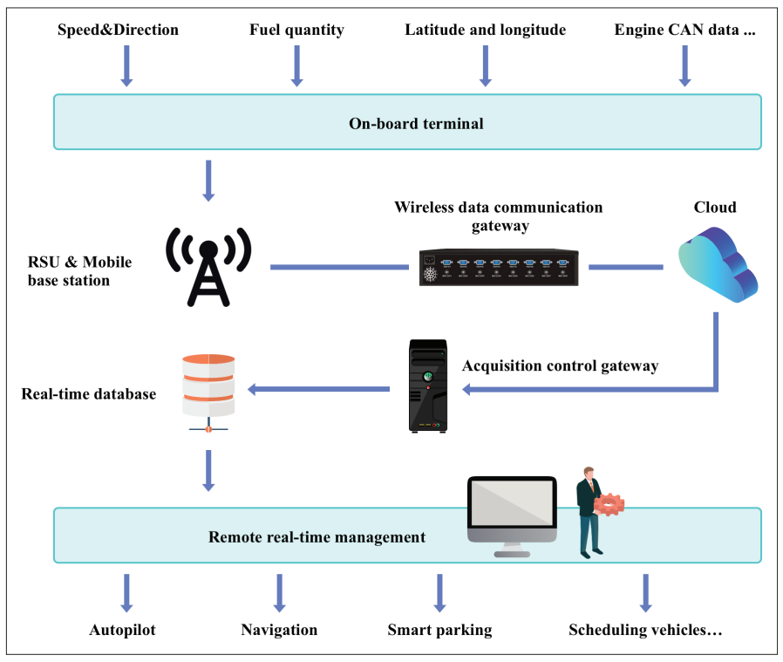
Structure of the IoV System

Slide 13
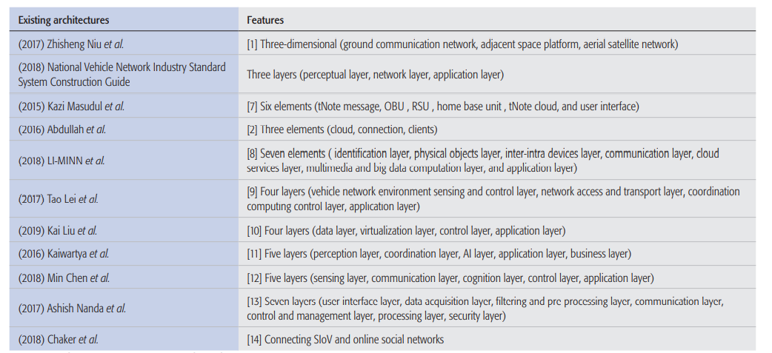
IoV Network Architectures
Several Network Architectures have been proposed by researchers over the past couple of years.

Slide 14
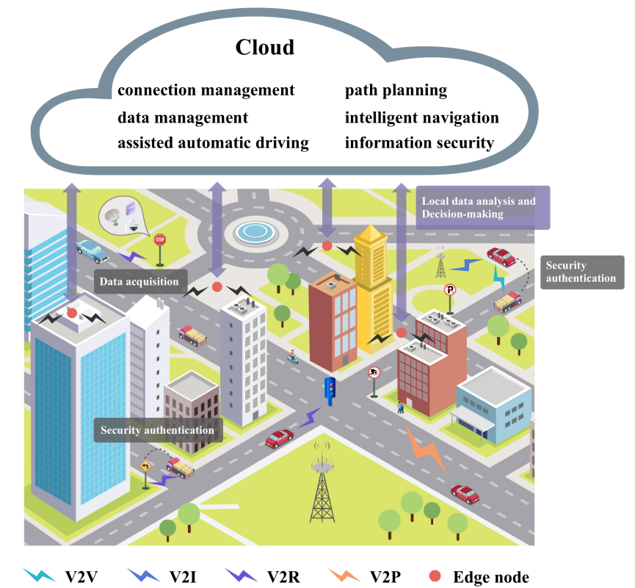
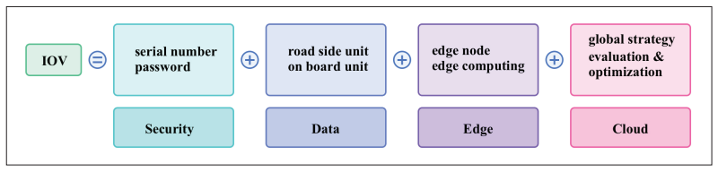
Proposed IoV Network Architecture
Collaborative Vehicle-Road-Cloud Architecture
By: Baofeng et al (2020)
Consists of 4 Layers
Security Authentication Layer
Authenticate Identity of Vehicles & RSUs
Data Acquisition Layer
Collect data for local action and communication with edge layer
Edge Layer
Published data analysis for real time local traffic events
Cloud Platform Layer
Big data processing and global information services
Fig: Application Scenario of the Proposed Architecture
Fig: Main Elements of the Proposed Architecture

Slide 15
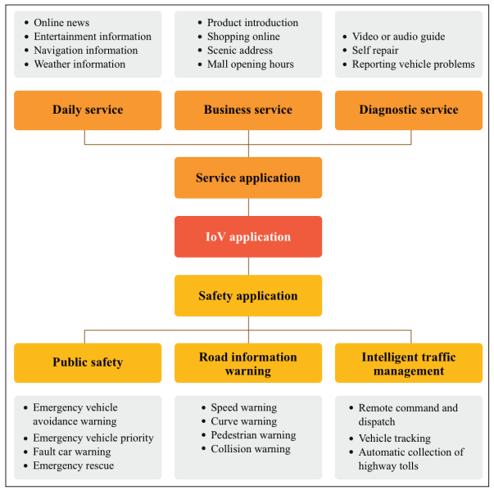
IoV Typical Applications
Applications in IoV can be summarized into two broad categories:
- Service Applications
Goal:
To improve driver and passenger experience
- Safety Applications
Goal:
Ensure safety of drivers, passengers, pedestrians and road side infrastructures

Slide 16
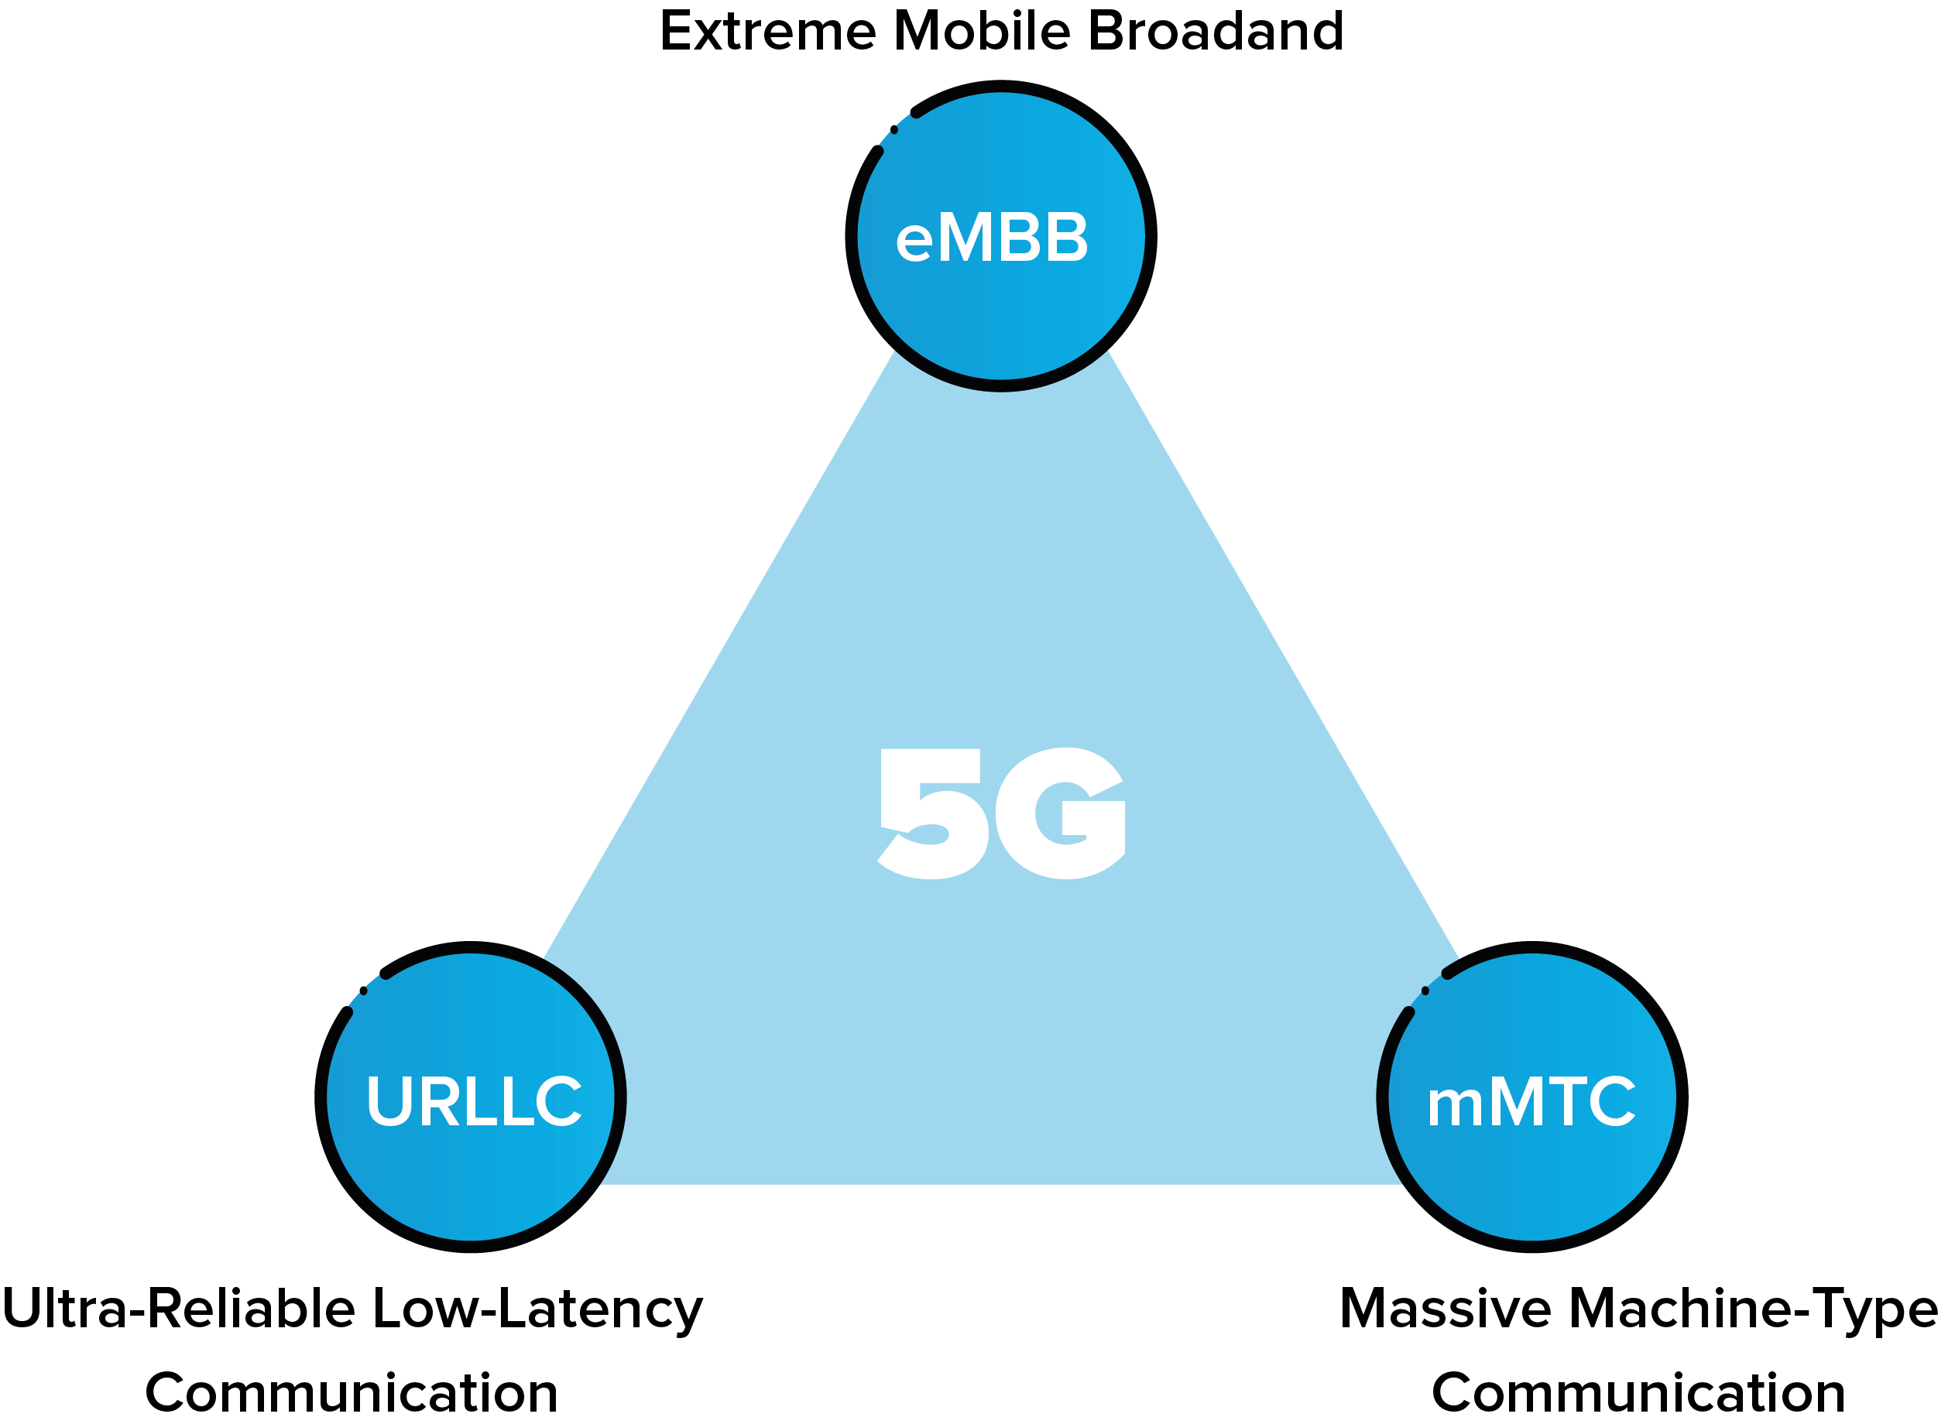
Influence of 5G/B5G on IoV
Big Data Acquisition and Transmission
Fast relay & exchange of data
V2X connections

Slide 17
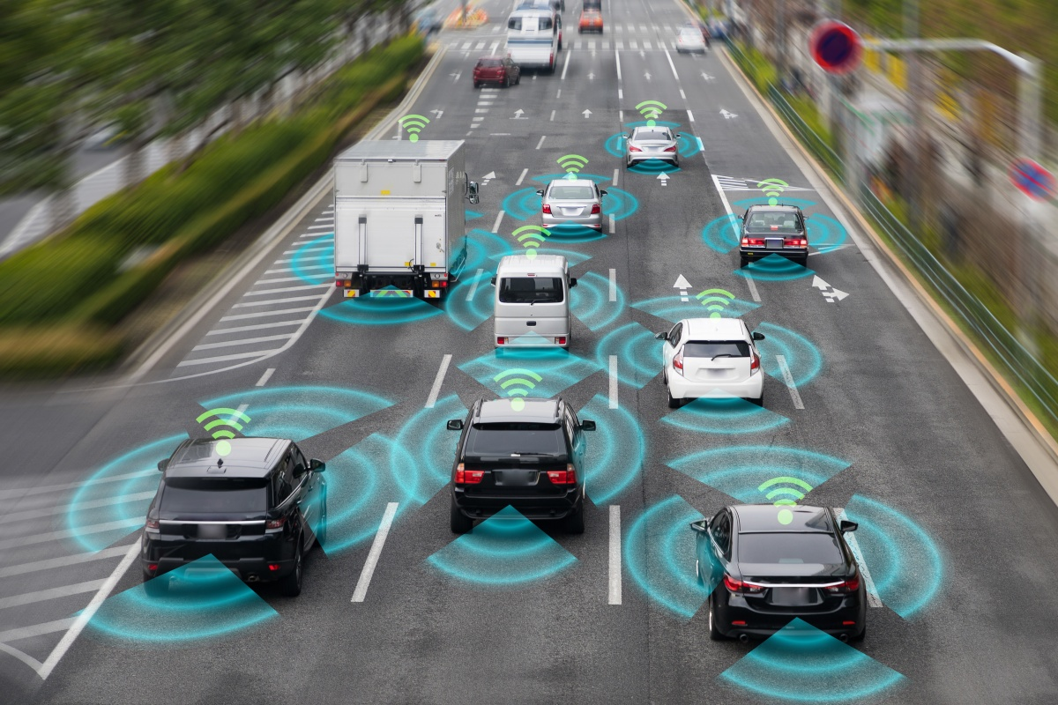
Conclusion
IoV Technology, though not fully developed and implemented, promises a great travel experience both for travelers and pedestrians. It also provides a fast and secure transportation service by making it possible for the exchange of information between vehicles and everything that can potentially affect the travel experience of vehicles.
Also, future projections of autonomous driving in addition to IoV will redefine transportation experience for all.

Slide 18
Thank You
YEBOAH-DUAKO ELVIS
MS, Computer Science & Technology
School of Computer Science & Engineering

